Slide 1
Session – 13
Extreme Programming

Slide 2
Recap for session 12
Agile Design
Agile Software Development
Value 1: Individuals and Interactions over Processes and Tools
Value 2: Working Software over Comprehensive Documentation
Value 3: Customer Collaboration over Contract Negotiation (1 of 2)
Value 4: Responding to Change over Following a Plan
Agile Principles (12)
Key components of Agile project management
What are the 6 steps in the Agile methodology?

Slide 3
Agenda for session 13
Extreme Programming
Extreme Programming (XP) Model
Success in Industry in XP
Extreme Programming Advantages

Slide 4
Extreme Programming
Extreme Programming (XP) is a well-known agile method; it emphasizes collaboration, quick and early software creation, and skillful development practices.
XP is a lightweight, efficient, low-risk, flexible, predictable, scientific, and fun way to develop a software.

Slide 5
Extreme Programming (Cont..)
Extreme Programming is one of the Agile software development methodologies. It provides values and principles to guide the team behavior. The team is expected to self-organize. Extreme Programming provides specific core practices where −
Each practice is simple and self-complete.
Combination of practices produces more complex and emergent behavior.

Slide 6
Why is it called “Extreme?”
Extreme Programming takes the effective principles and practices to extreme levels.
Code reviews are effective as the code is reviewed all the time.
Testing is effective as there is continuous regression and testing.
Design is effective as everybody needs to do refactoring daily.
Integration testing is important as integrate and test several times a day.
Short iterations are effective as the planning game for release planning and iteration planning.

Slide 7
Extreme Programming (Cont…)
XP founded on four values:
communication, simplicity, feedback, and courage.
In addition to IID, it recommends 12 core practices:
1. Planning Game 7. pair programming
2. small, frequent releases 8. team code ownership
3. system metaphors 9. continuous integration
4. simple design 10. sustainable pace
5. testing 11. whole team together
6. frequent refactoring 12. coding standards

Slide 8
Extreme Programming (XP) Model
XP Planning
  Begins with the creation of “user stories”
  Agile team assesses each story and assigns a cost
  Stories are grouped to for a deliverable increment
  A commitment is made on delivery date
  After the first increment “project velocity” is used to help define subsequent delivery dates for other increments

Slide 9
Extreme Programming (XP) model (Cont…)
XP Design
  Follows the KISS(Keep it Simple, Stupid) principle
  Encourage the use of CRC cards (Class Responsibility Collaboration)
  For difficult design problems, suggests the creation of “spike solutions”—a design prototype( A Working Model)
  Encourages “refactoring”—an iterative refinement of the internal program design
XP Coding
  Recommends the construction of a unit test for a store before coding commences
  Encourages “pair programming”
XP Testing
  All unit tests are executed daily
  “Acceptance tests” are defined by the customer and executed to assess customer visible functionality

Slide 10

Extreme Programming (XP) model cont…

Slide 11
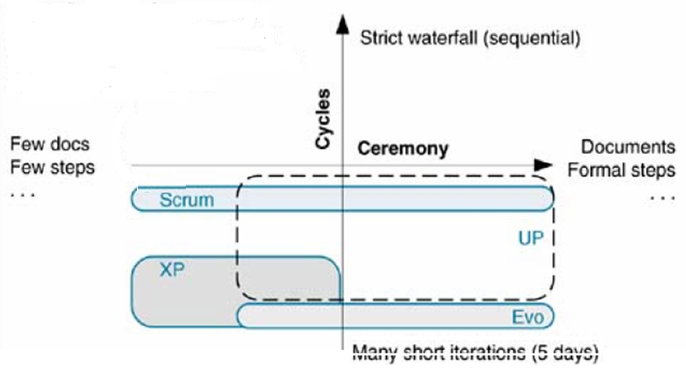
Extreme Programming (XP)
Method Overview

Slide 12
Work products Roles and Practices
Extreme Programming (XP) Model (cont ..
Work Products (Non Software):
-Requirements – Story Cards
-Design- CRC Cards, Sketches
-Project Management- Task list, Visible graphs
Roles:
-Custumer
-Development
-Management
-Other
Practices:
-Requirements
-Design
-Implementation
-Test and Verification
-Project Management
-Configuration & Change management environment

Slide 13
Success in Industry in XP
The success of projects, which follow Extreme Programming practices, is due to −
Rapid development.
Immediate responsiveness to the customer’s changing requirements.
Focus on low defect rates.
System returning constant and consistent value to the customer.
High customer satisfaction.
Reduced costs.
Team cohesion and employee satisfaction.

Slide 14
Extreme Programming Advantages
Extreme Programming solves the following problems often faced in the software development projects −
Slipped schedules − and achievable development cycles ensure timely deliveries.
Cancelled projects − Focus on continuous customer involvement ensures transparency with the customer and immediate resolution of any issues.
Costs incurred in changes − Extensive and ongoing testing makes sure the changes do not break the existing functionality. A running working system always ensures sufficient time for accommodating changes such that the current operations are not affected.
Production and post-delivery defects: Emphasis is on − the unit tests to detect and fix the defects early.

Slide 15
Questions
List out Core practices in Extreme Programming.
Explain Extreme programming Life cycle.
Illustrate XP Work products Roles and Practices for safe home application.
Write extreme programming advantages and disadvantages?
How User requirements are expressed in Extreme Programming.

